Slide 1
York Code Dojo “Ray Tracing”
Chris Maughan
mornymorny@gmail.com
Coder @ NVIDIA

Slide 2

Finding Dory

Slide 3
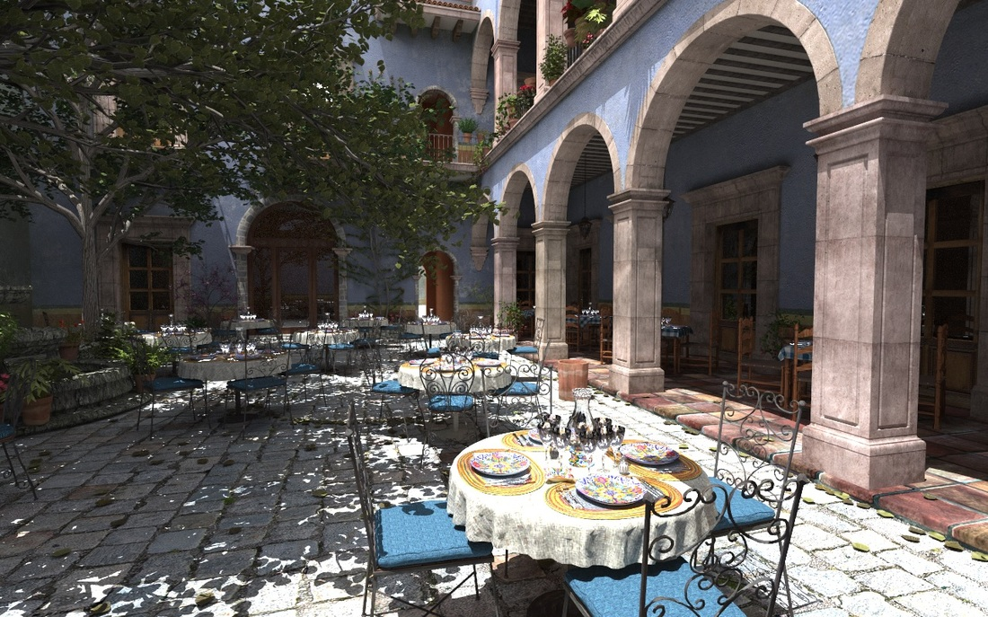
PBRT San Miguel Scene

Slide 4
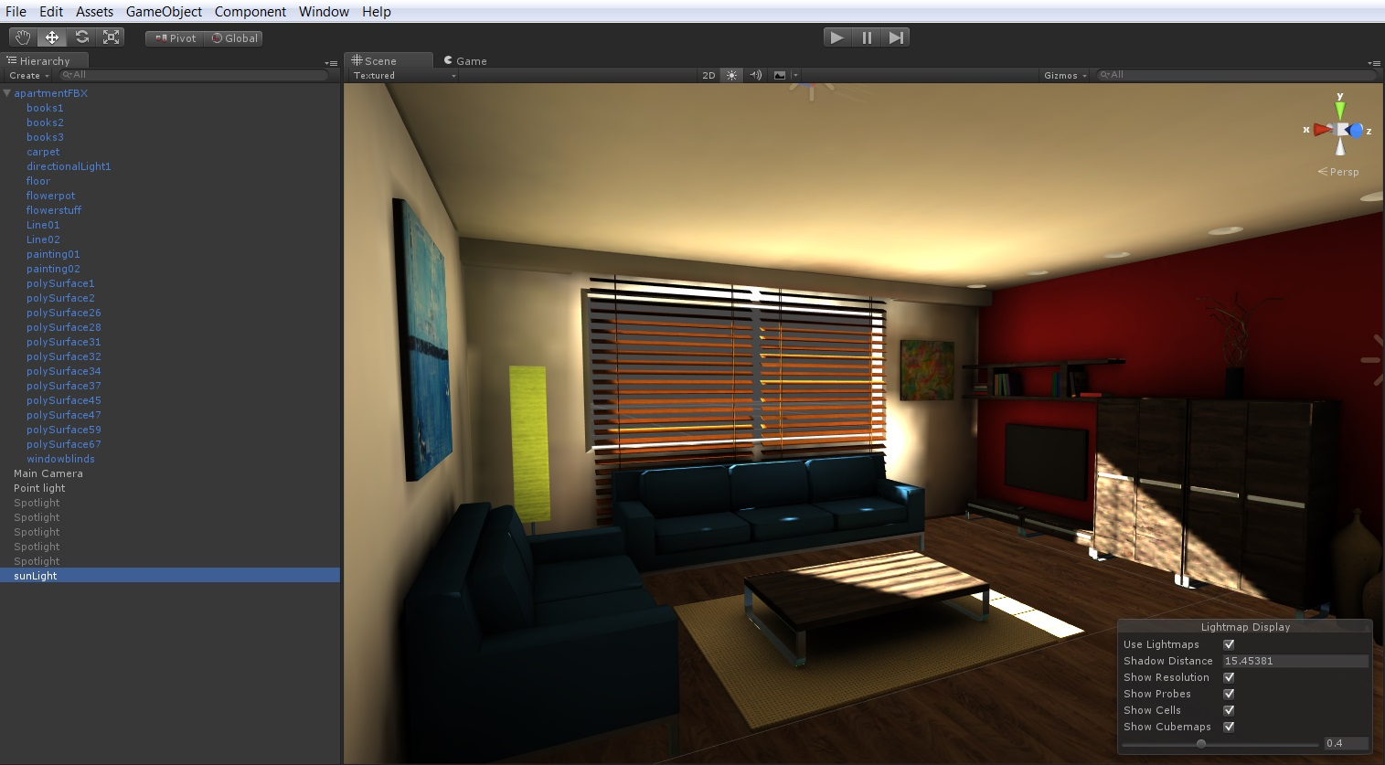
Unity 5 LightMaps using PowerVR Ray Tracer

Slide 5

Glass

Slide 6
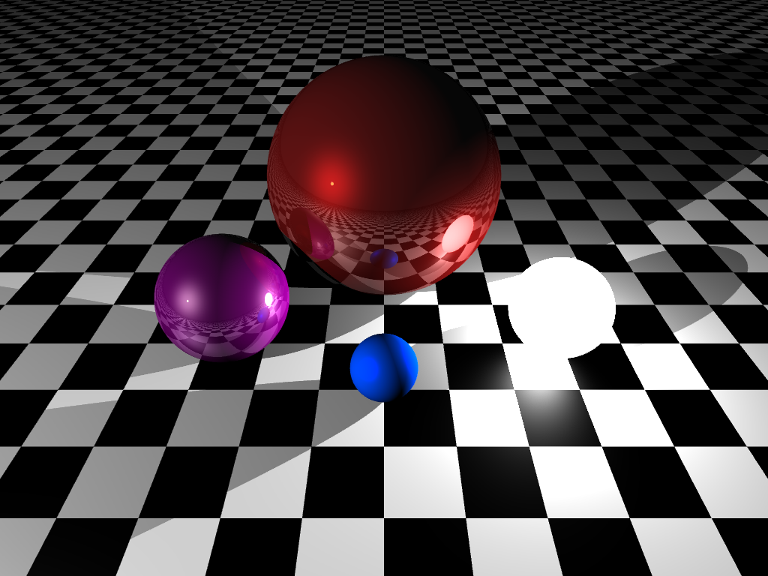
Results….

Slide 7
Thanks
Doug/Isotoma for the Pizza, Drinks and Venue

Slide 8
Meetups!
York Game Developers, 3rd Thursday, The Crown, York
http://www.meetup.com/York-Game-Developers/
York Code & Coffee – Wednesday 7AM+, Perky Peacock Lendal
http://www.meetup.com/York-Code-Coffee/
Leeds Code Dojo
http://www.meetup.com/Leeds-Code-Dojo/

Slide 9
Slack – York Developer Community
Mail me, David or Daniel to get on the group
yorkdevelopers.slack.com
For coders in the York area
Channels for #gamedev, #codeandcoffee, #yorkcodedojo,#development,….

Slide 10
Questions ?

